Slide 1
A Race Against Melt
Mapping Arctic Ice
Anneli Sorensen, Steve Desch
Arizona State University
SESE

Slide 2
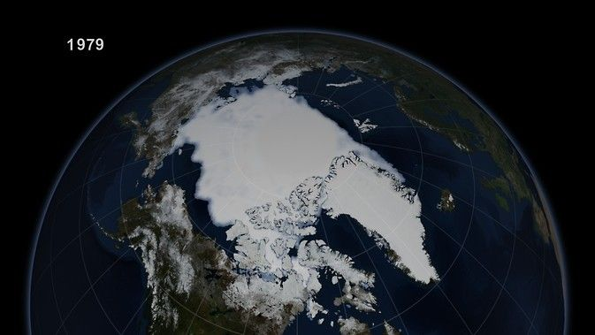

Slide 3

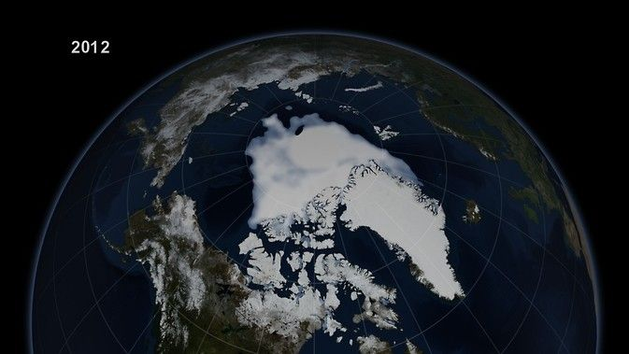
The Loss

Slide 4
Objective
How can pumping water in strategically chosen areas help to preserve and thicken Arctic ice?

Slide 5
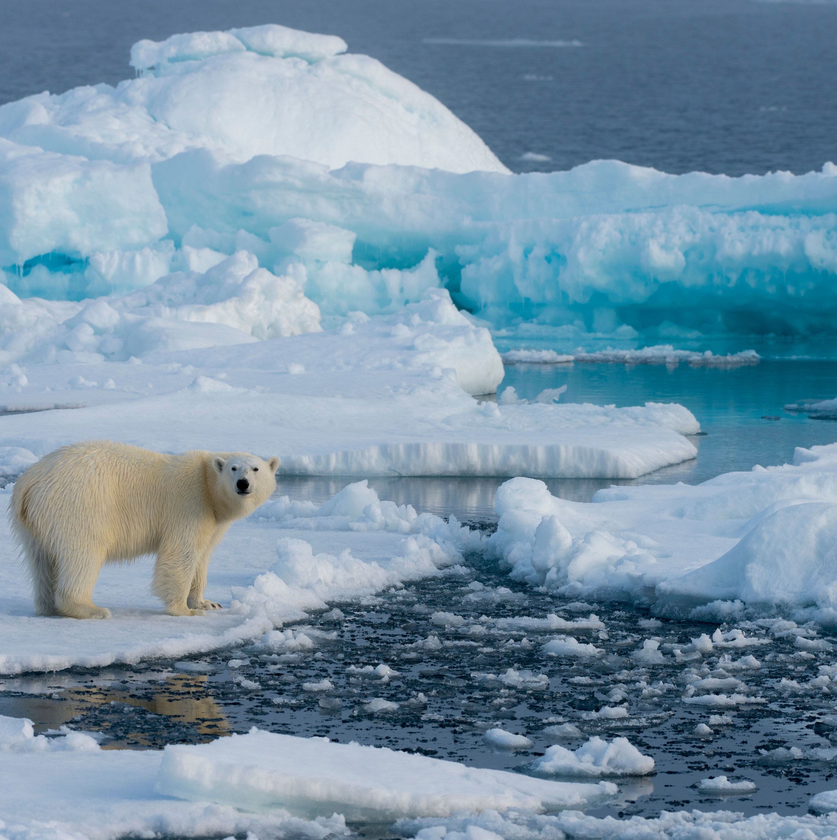
01
Why Arctic Ice Matters
https://arcticportal.org/maps/download/arctic-definitions

Slide 6
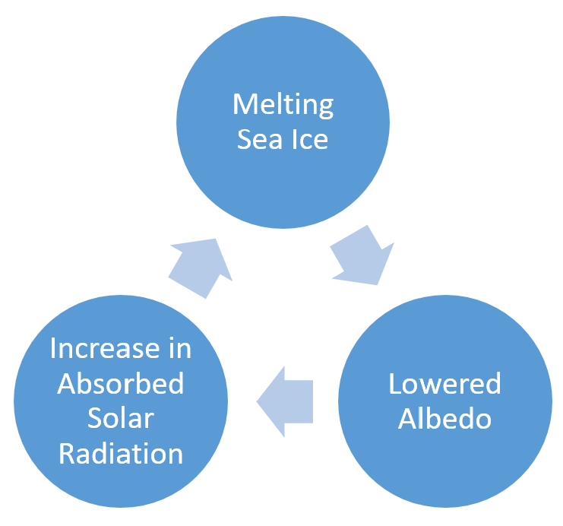
Why it Matters
13% ice loss each decade since 1979
Albedo drops up to 50%
Arctic ice reflects 60–90% of solar radiation
Ocean heat uptake increased by ~0.3 W/m²
40% drop in ice threatens ecosystems
https://www.google.com/url?sa=i&url=https%3A%2F%2Fmynasadata.larc.nasa.gov%2Fmini-lessonactivity%2Fdoes-albedo-affect-arctic-populations&psig=AOvVaw3JjXWGCOGQokdkuLNggThG&ust=1743828028103000&source=images&cd=vfe&opi=89978449&ved=0CBcQjhxqFwoTCKiYl-PHvYwDFQAAAAAdAAAAABAE

Slide 7

02
Methodology
[Link to Github Repository]

Slide 8
Methods
Built upon previous research under Steve Desch
Utilized CICE-Consortium’s “Icepack”
Extended code for multi-region adaptability
Used CMIP-5 dataset for realistic results
Identified optimal water pumping sites for ice preservation

Slide 9
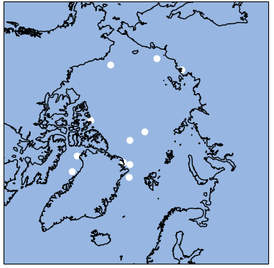
Testing Locations
Criteria
Multi-Year Ice Presence
Stabilizes climate feedbacks and extends sea ice longevity
Human Usage
Ensures sustainable resources and Arctic navigation routes
Ecosystem Significance
Safeguards habitats, biodiversity, and ecological balance

Slide 10
Version 1
Version 2
Changes
Changes
Updated previous works to current version
Investigated effect of pumping water on top of the ice
Added features to Icepack to calculate the changes in ice volume
Pros
Pros
Best for analyzing salinity and snow-ice interactions
Best for examining effects of increased ice thickness
Cons
Cons
Not designed to accurately capture ice thickness changes
Does not accurately capture salinity or snow-ice interactions

Slide 11
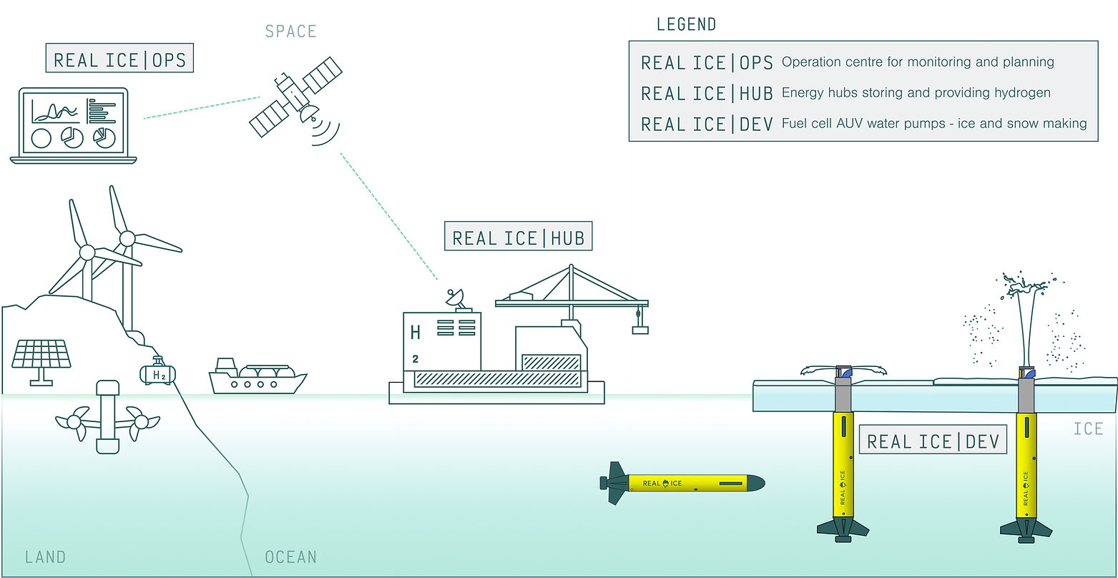
03
Version 1
https://www.realice.eco/science

Slide 12
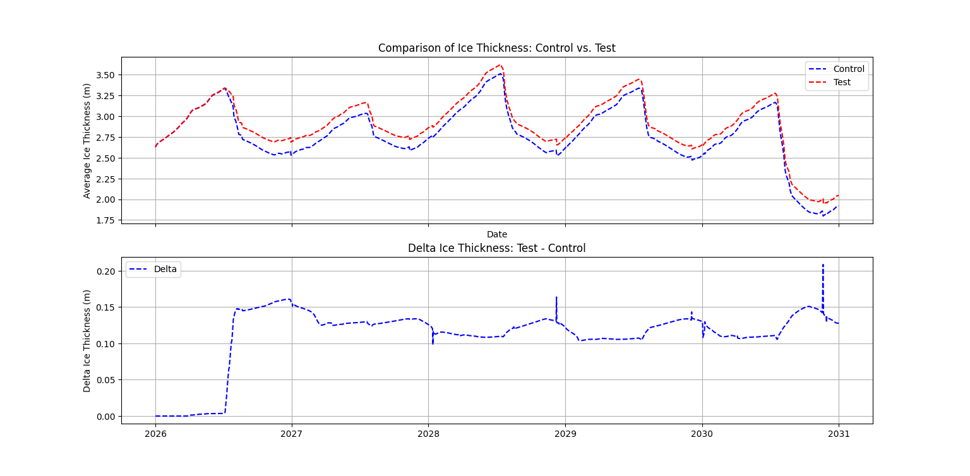
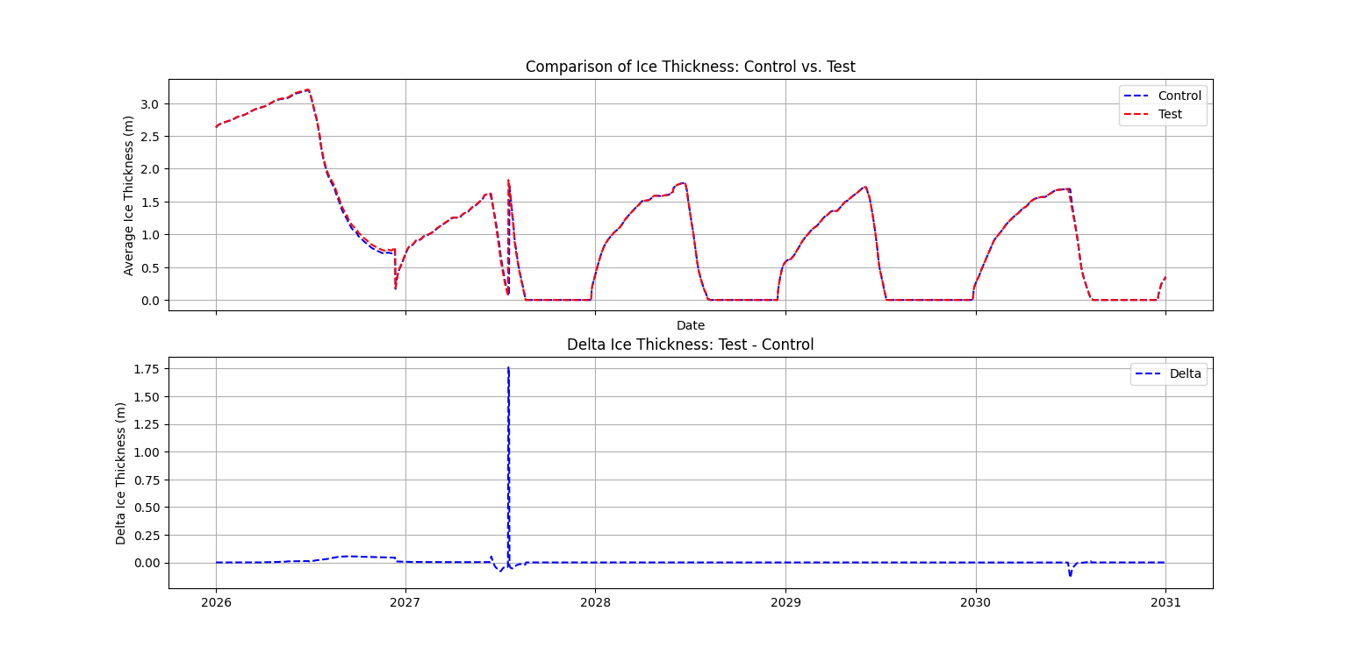
Version 1 Results
Simulated for 5 years from 2026 to 2031
Ice thickness increased .01 to .06 m
Salinity decreased .008 to .02 ppt
Best: Greenland
Ice thickness increased .13 m
Salinity decreased .082 ppt
Worst: Kara Sea
No change to ice thickness
Salinity decreased .0038 ppt

Slide 13
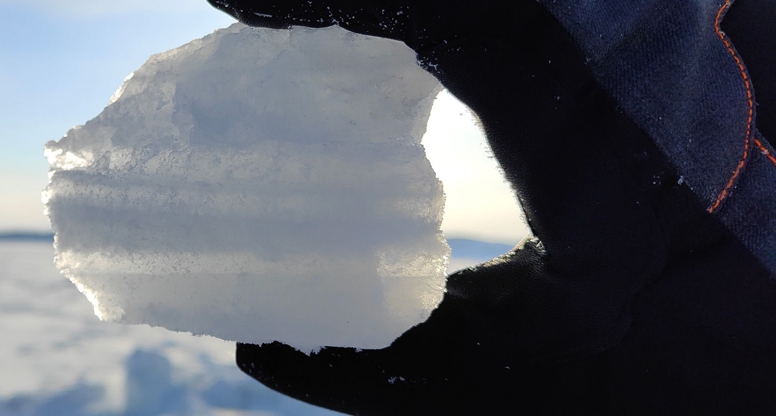
04
Version 2
https://www.realice.eco/mission

Slide 14
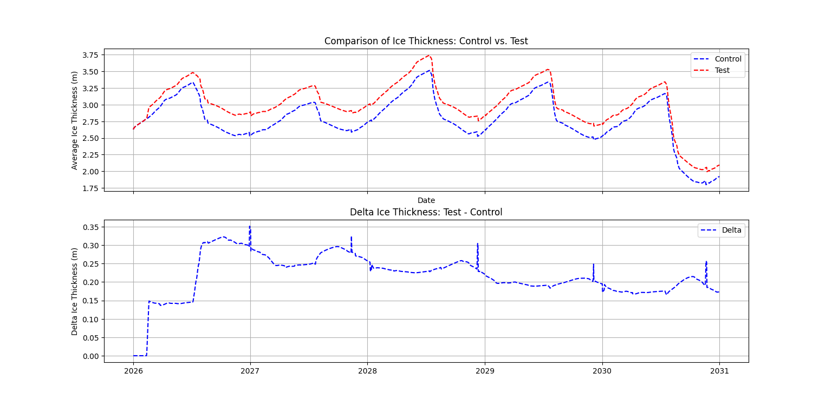
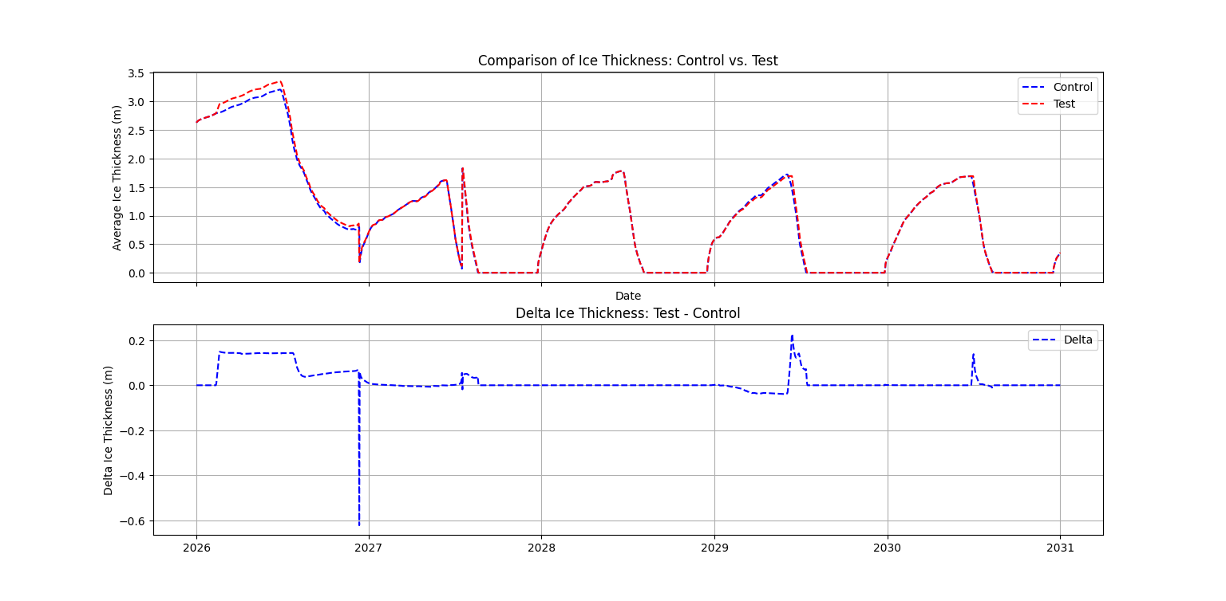
Version 2 Results
Simulated for 5 years from 2026 to 2031
Ice thickness increased .06 to .14 m
Salinity decreased .01 to .024 ppt
Best: Greenland
Ice thickness increased .18 m
Salinity decreased .04 ppt
Worst: Kara Sea
No change to ice thickness
Salinity decreased .0039 ppt

Slide 15
Version 1
Version 2

Slide 16
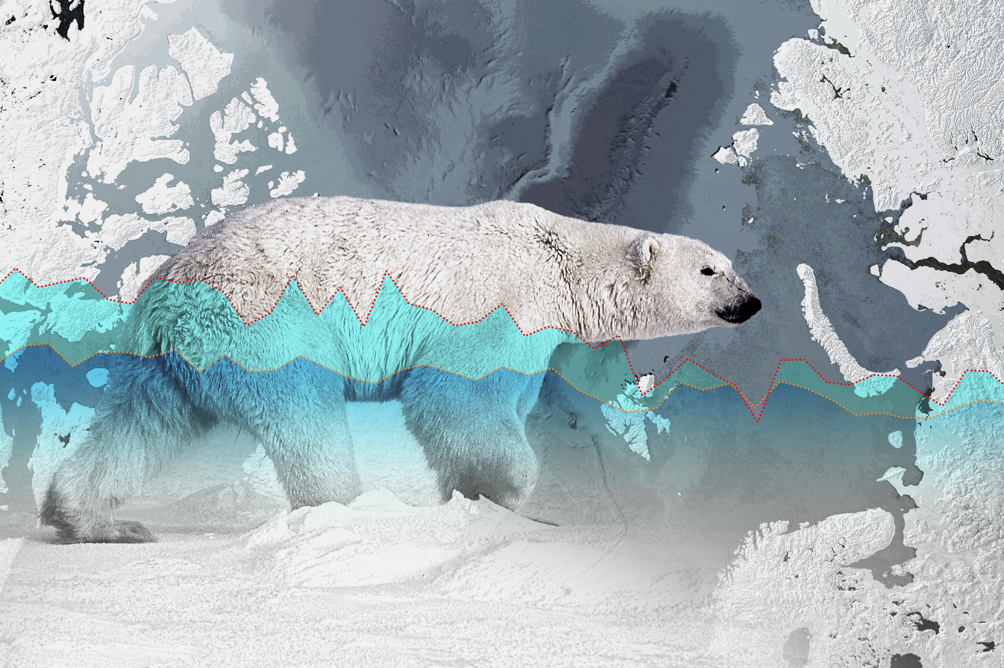
05
Takeaways
https://www.theepochtimes.com/article/un-says-melting-arctic-ice-is-a-key-indicator-of-climate-change-but-its-not-melting-5580038

Slide 17
Takeaways
Ice increase of 10–20 cm can delay melt and boost reflectivity
Increased ice coverage can reduce Arctic warming by up to 0.2°C
Multi-year ice survival improved by up to 30%
15% more multi-year ice preserves key habitats for Arctic species
Proactive efforts may offset billions in climate adaptation costs
Scaling requires interdisciplinary research and strong policy backing

Slide 18


Acknowledgments
This work was made possible with the guidance of Dr. Steven Desch. This work was funded by the Arizona Space Grant. Thank you to Cice-Consortium and their “Icepack” code. Thank you to all that made this possible.
References
1 ) Desch, S., Rantanen, M., & Vargas, P. (2016). The role of sea-ice dynamics in the Arctic climate system: An integrated modeling approach. Earth's Future, 4(11), 500–518. https://doi.org/10.1002/2016EF000410. 2) Vargas, P. (2017). Icepack: A Numerical Model for Ice Dynamics [GitHub repository]. Retrieved from https://github.com/percurnicus/Icepack. 3) CICE Consortium. (2024). Icepack (Version 1.5.0) [Software]. Zenodo. https://doi.org/10.5281/zenodo.14188409 4) NASA. (2024). Arctic sea ice dynamics image. NASA Earth Observatory. Retrieved from https://earthobservatory.nasa.gov. 5) Wikipedia Contributors. (2024). Arctic Circle. Wikipedia. Retrieved from https://en.wikipedia.org/wiki/File:Arctic_circle.svg. 6) Lawrence Livermore National Laboratory. (2024). Data retrieved for sea-ice modeling. Lawrence Livermore National Laboratory. Retrieved from https://www.llnl.gov.

Slide 19

Thank you!
Anneli “Lee” Sorensen
asorens9@asu.edu

